Slide 1
Team ADAS
https://github.com/tarlit/Team_Adas_BullsAndCows2

Slide 2
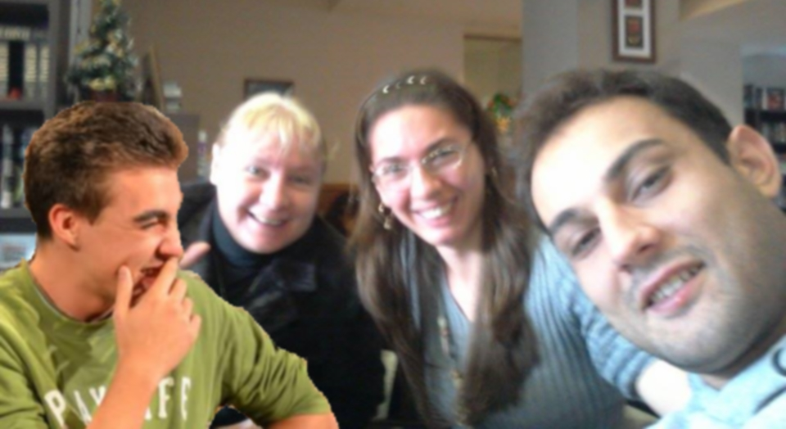
WHO
Банкин
Габи
Таня
Манов

Slide 3

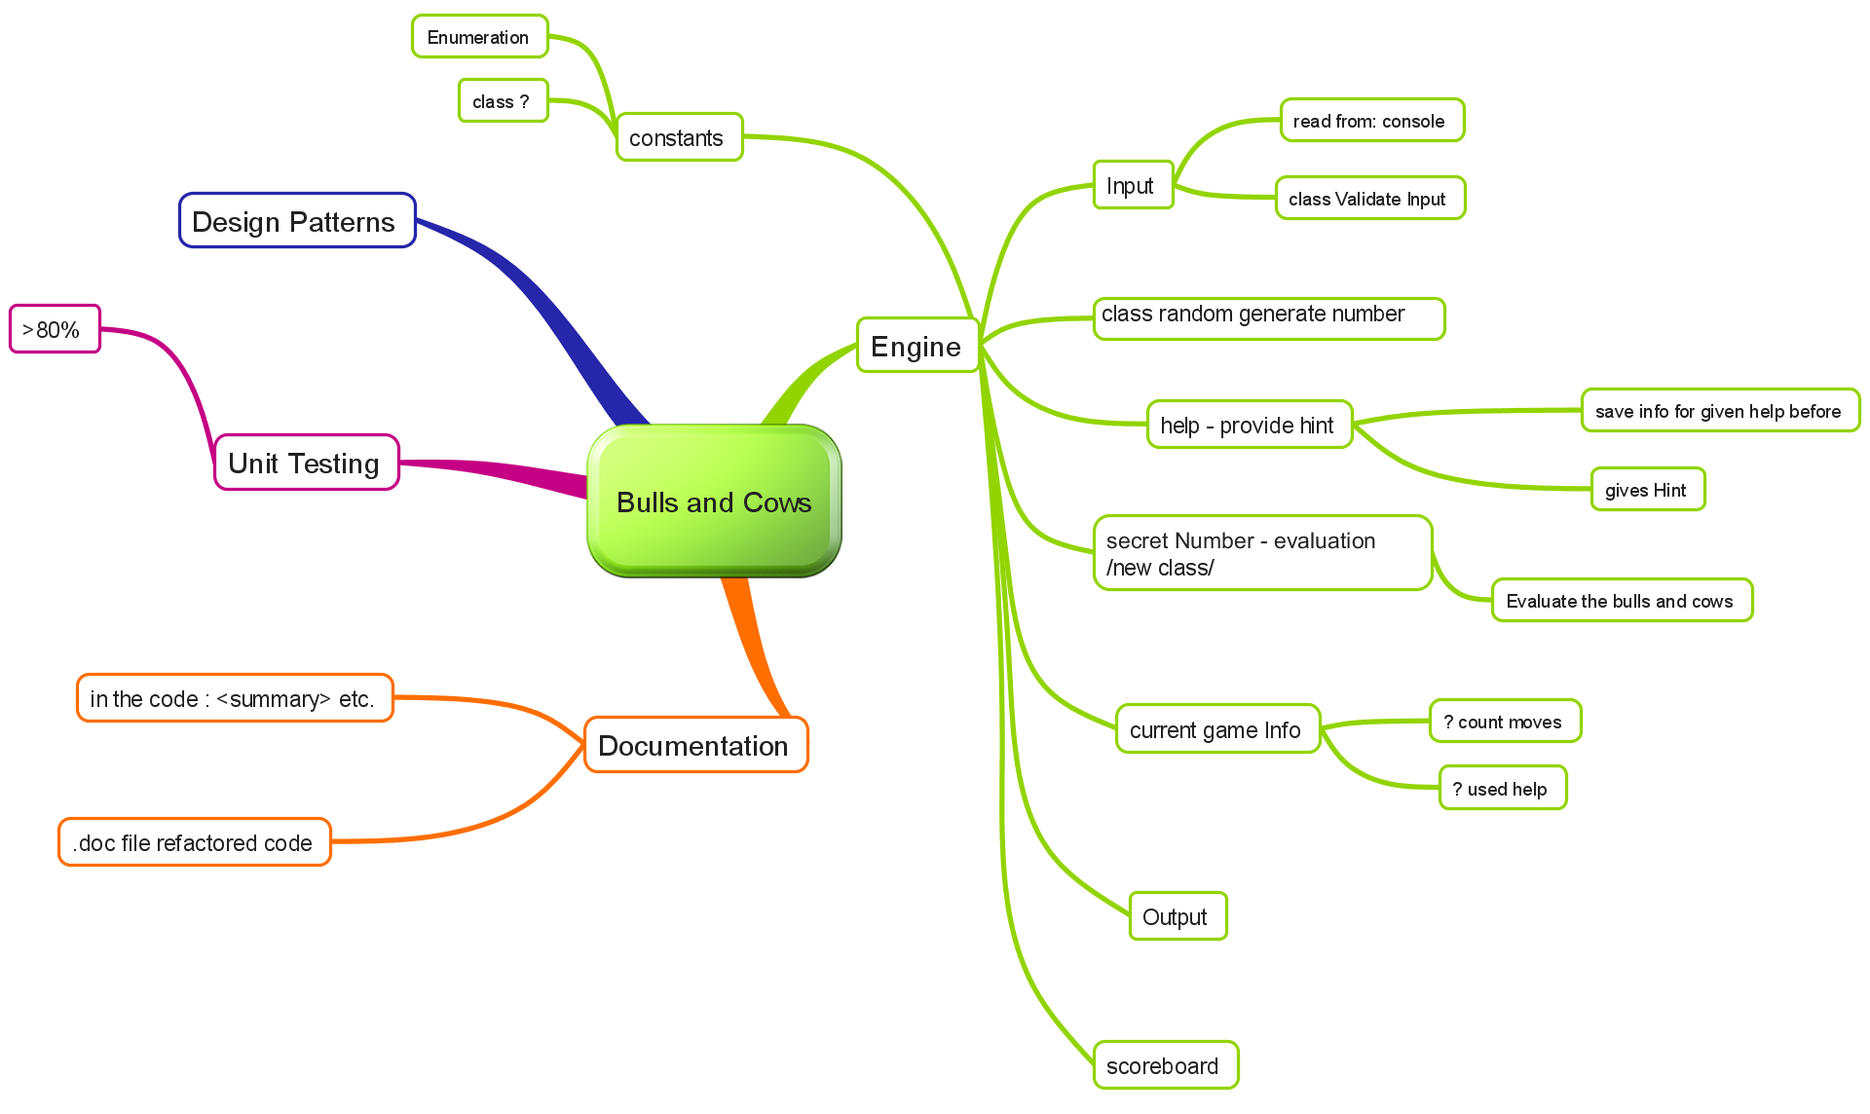
WHAT & HOW

Slide 4

DEMUUUUUUUU

Slide 5

Questions?

